Slide 1
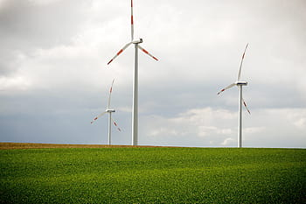
PREDICTING WIND ENERGY OUTPUT BASED ON WEATHER CONDITIONS

Slide 2
Problem Description
Wind energy plays an increasing role in the supply of energy worldwide. The energy output of wind turbines is highly dependant on the weather conditions present in its region, the direction of the wind, and the effect of trade winds in the region during one weather.
The maintenance and efficient working of the wind turbines is highly dependant on the periodic inspections that have to be done on each wind turbine after a certain period or amount of usage. Anticipating maintenance requirements and failures can be highly cost-saving.
The statistical predictive algorithms are not robust to changing environmental conditions and can be impractical for long term usage.

Slide 3
PROPOSED SOLUTIONS
A Machine Learning based predictive model that uses wind speed, wind direction to predict the energy output of 1 hour to 72 hours.
We have used a multivariate SCADA (Supervisory control and data acquisition) dataset that have multiple observations taken in every 10 minutes for one year.
Since the energy generated from the windmills get wasted if not used at the moment and battery storage, pump storage hydro electricity, or compressed air storage are costly and have a finite capacity, the predictive model suggests better working schedules for the industries.

Slide 4
NOVELTY / UNIQUENESS
The proposed predictive model uses the LSTM network that maintains output dependencies on previous predictions and carries the information for a long period of time rather than performing statistical predictions.
The model is adaptive towards changes in the environment by using state of the art reinforcement learning techniques that adjusts the weights depending upon the loss generated in each prediction.
From the active and theoretical power, the model anticipates for maintenance and failures.

Slide 5
BUSINESS / SOCIAL IMPACT
Benefits for Industries and companies:
Schedule heavy power usage before hand to avoid costly overproduction.
Coordinate with different energy sources to compensate the energy requirement
Low production cost and use of renewable power source.
Benefits for household Consumers:
Renewable and low cost power supply for household utilities.

Slide 6
BUSINESS / SOCIAL IMPACT CONTD..
Benefits for Windmill Plants:
Schedule predictive maintenance instead of periodic inspection.
Predict new installation location in promising regions.
Recruit technicians depending on the frequency of maintenance.
Social Impact:
More reliance on renewable sources of energy like wind energy that is available without any cost and doesn’t produce pollutants or greenhouse gases.

Slide 7
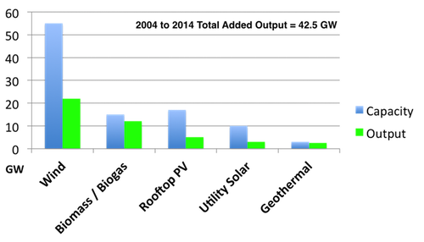
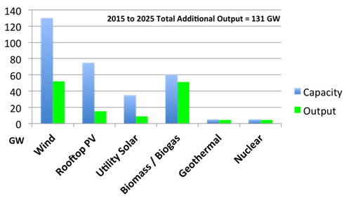
STATISTICS ON SOURCES OF ENERGY

Slide 8
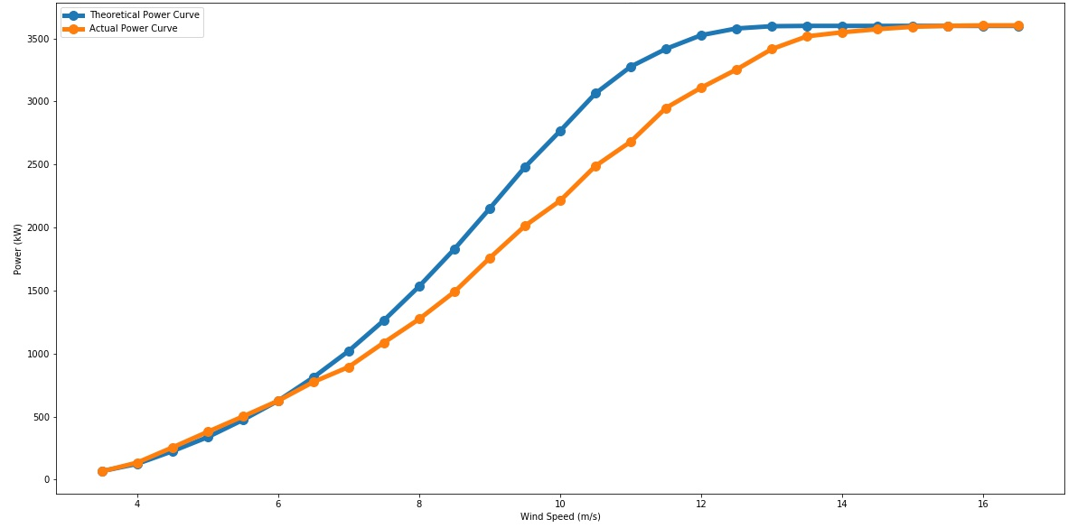
VISUALIZATION
The raw output data can be made easier to understand and user-friendly using graphical representation

Slide 9
DASHBOARD
Real-time monitored data is fed back to the database for updating the weights for reinforcement learning.
Admin Panel: The industries or firm management system where the stakeholder has to decide how to forecast the predictions considering the regional windmill data and the scale of industries based on power consumption.
Service bearer Panel: Simple and intuitive representation of the predicted power outputs in regular intervals giving information about availability of power and some expected weather fluctuations.

Slide 10
TECHNICAL FLOWCHART
Standardize the time series by removing the mean and scaling to unit variance
Training a LSTM network on 80% of the data.
PREPROCESSING
MODEL BUILDING
INPUT/OUTPUT FEATURES
REINFORCEMENT LEARNGING
Transforming the scaled time series into X, Y dataset
Assessing the performance of the model and adjusting the weights according to the loss

Slide 11
TECHNICAL STACK
LIBRARIES: PYTORCH, NUMPY,
CONCEPTS: RNN, CNN, REINFORCEMENT LEARNING
WEB TECHNOLOGY: HTML, AJAX, CSS, PHP, JAVASCRIPT, BOOTSTRAP, JQUERY, JSON, FLASK/DJANGO
HOSTING SERVICES: IBM CLOUD

Slide 12
SCOPE OF WORK
Predicting the power outputs in advance will result in the optimal utilization of energy resources to ensure maximum utilization of windmill energy.
By observing and predicting the power we can set up windmill farms on the location where there might be better wind energy resources by studying the average wind speed and direction of the wind.
Optimization of power distribution system so that the energy of windmill gets used up in synchronization with other energy resources like hydroelectricity and thermal electricity which would also help in minimizing the use of other non-renewable resources.
One day prediction is appropriate for interconnected power system operations such as unit commitment, conventional generators scheduling, as well as one day electricity markets.

